Slide 1
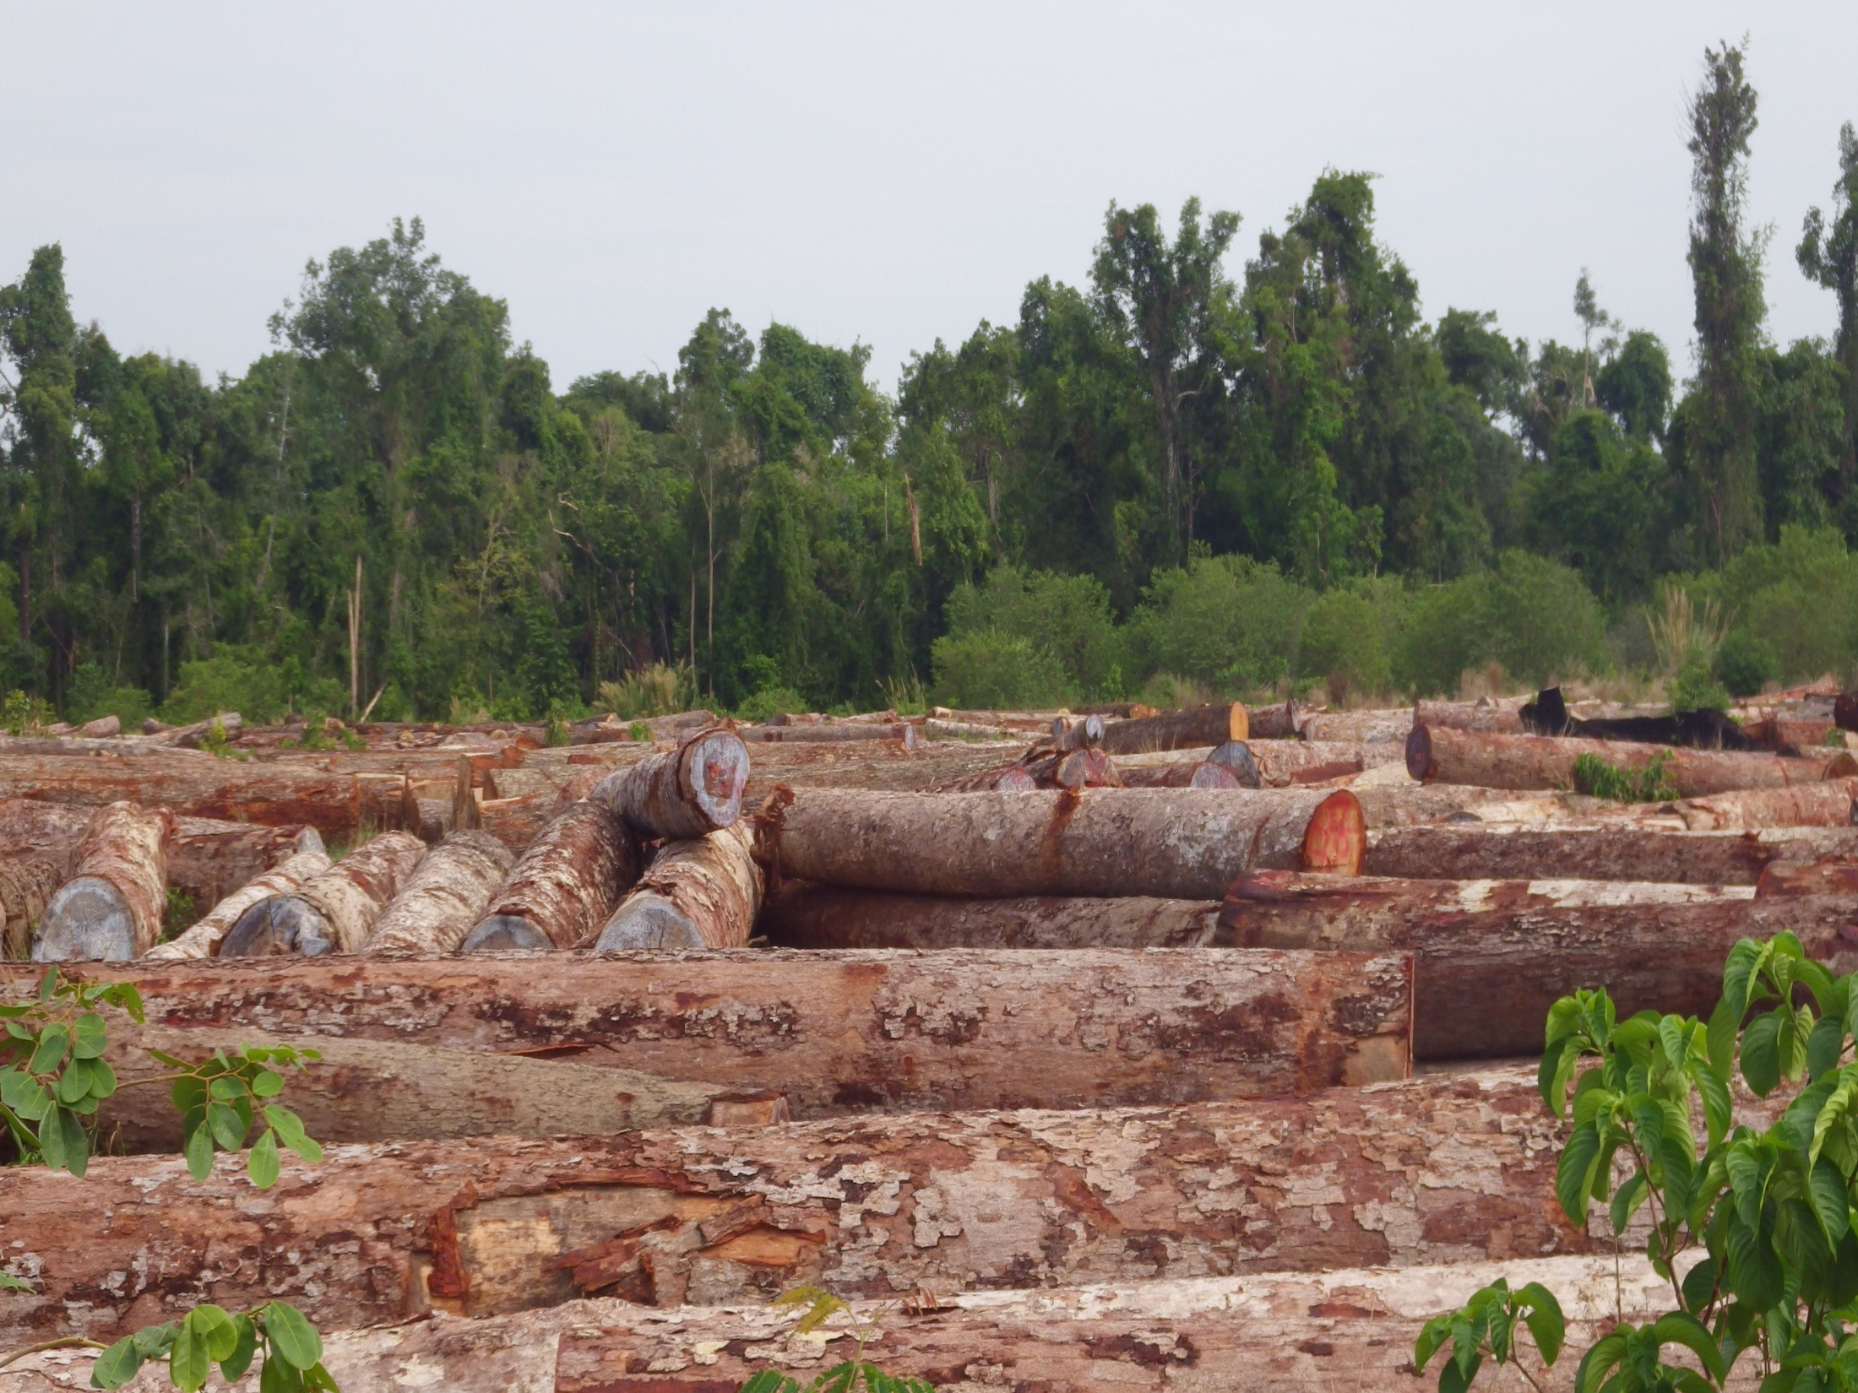
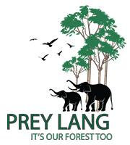
Conflict Resolution and Forest Protection
Prey Lang(Our Forest)-Cambodia
By Mr Houen Sopheap and Mrs Phon Sopheak – Prey Lang Community Network Representatives

Slide 2
The Prey Lang Community Network (PLCN) is a volunteer grassroots movement that works to preserve Prey Lang forest. PLCN is made up of active members in more than half of Prey Lang’s 339 communities which span the four Prey Lang provinces: Kratie, Stung Treng, Kampong Thom, and Preah Vihear.

Slide 3
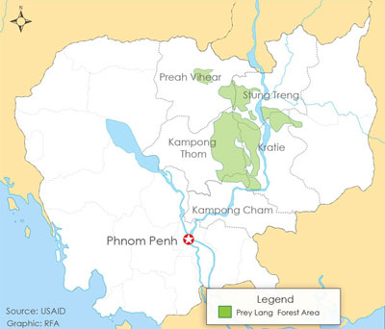
Location

Slide 4
Some Statistics
Size: Roughly 3600 square kilometers of forest.
People: About 200,000 people, mostly indigenous Kuy (pronounced Koo-ie,) live in 339 villages in six districts surrounding the forest.
Plant and Animal: 20 endangered plant species and as many as 27 endangered animal species
Climate Change: Prey Lang has some of the highest carbon sequestration values in the region, making it a powerhouse in the fight against climate change.

Slide 5
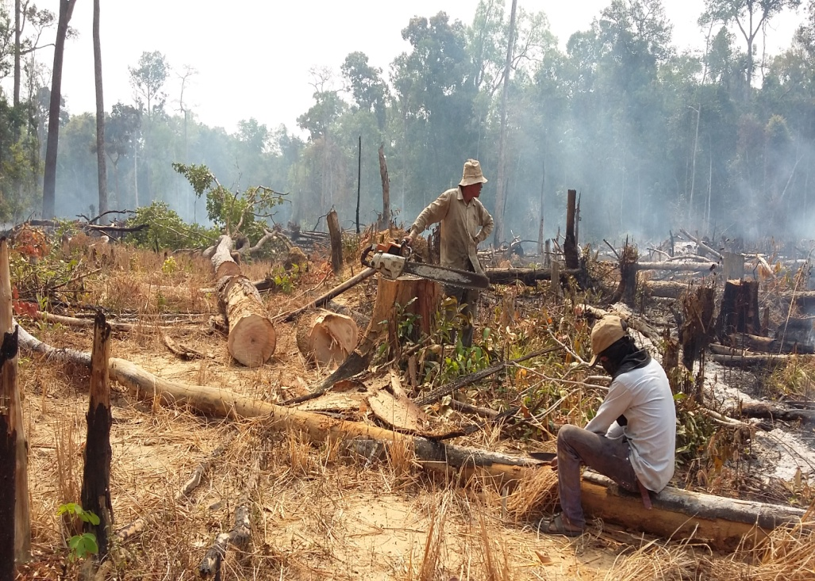
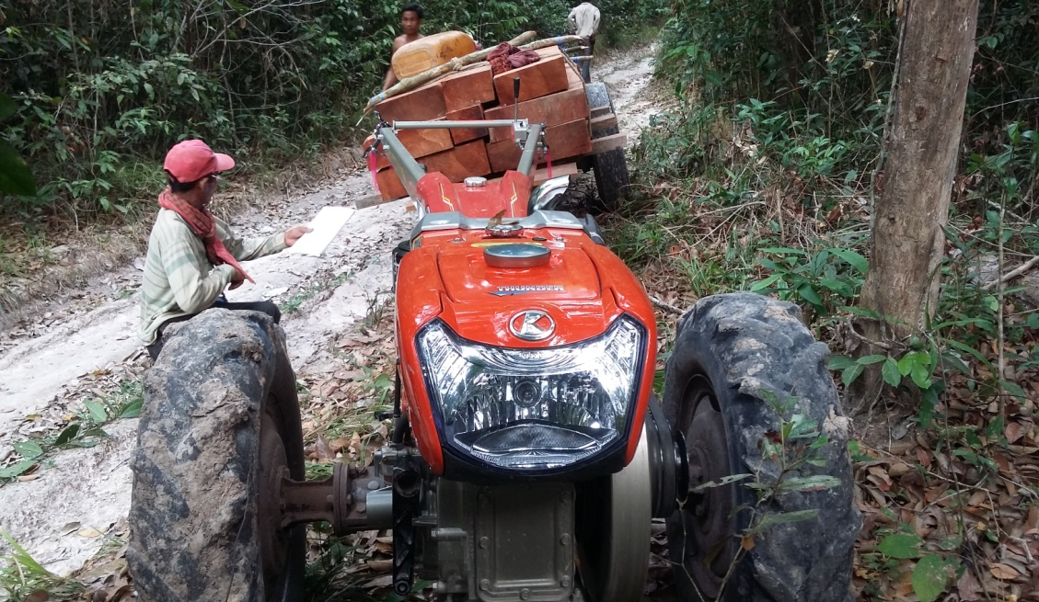
Conflict Situations
Confrontation with illegal logger during forest patrol (possible violence)

Slide 6
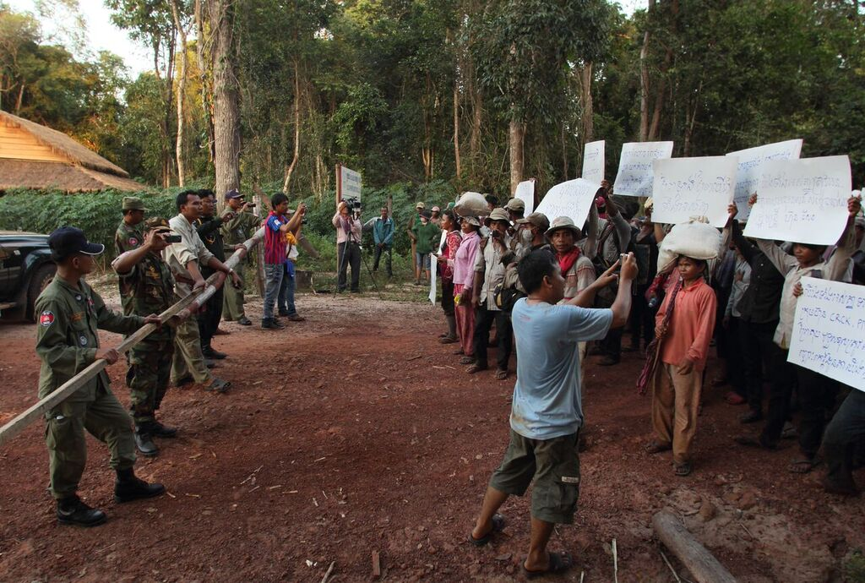
Confrontation with some individual local authorities who directly and indirectly involved in illegal logging.
Receive verbal threat from people involved in illegal logging business and private economic land concession companies.

Slide 7
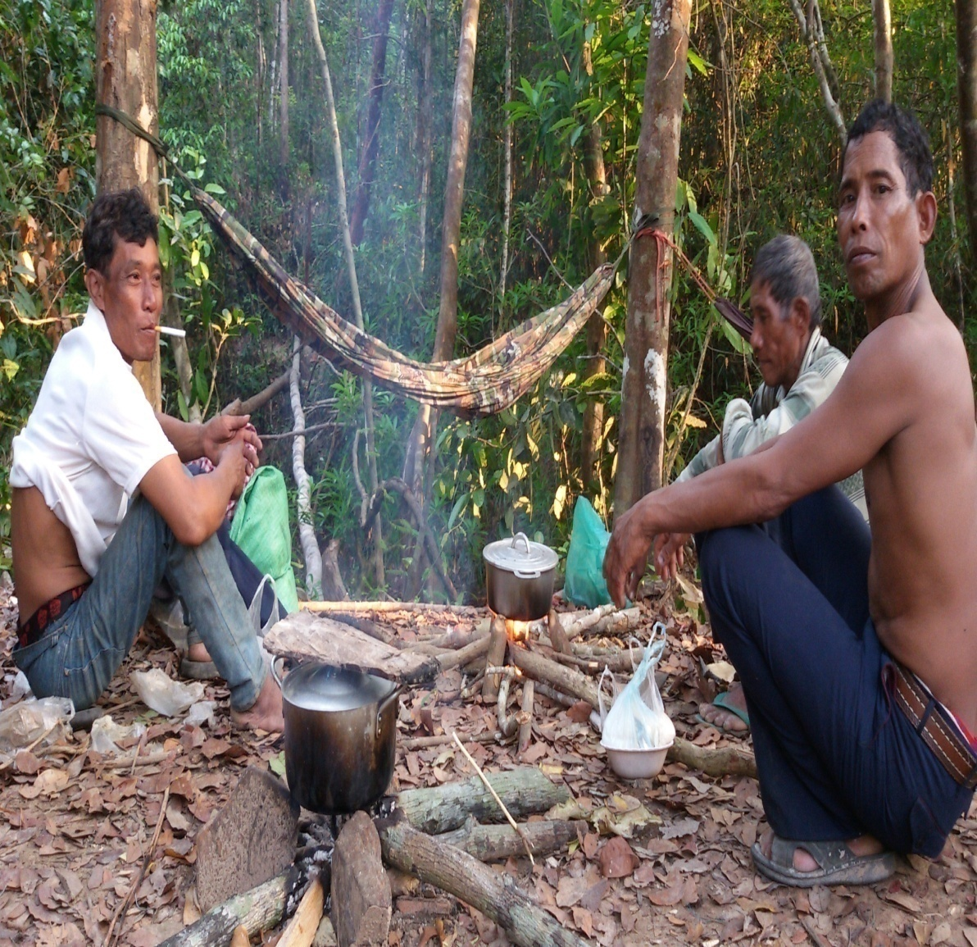
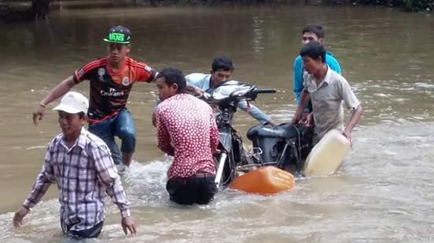
4. Internal clash/conflict or breaking unity between community activists incited by illegal loggers and/or some individual local authorities who involved in illegal logging.

Slide 8
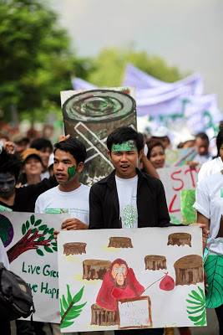
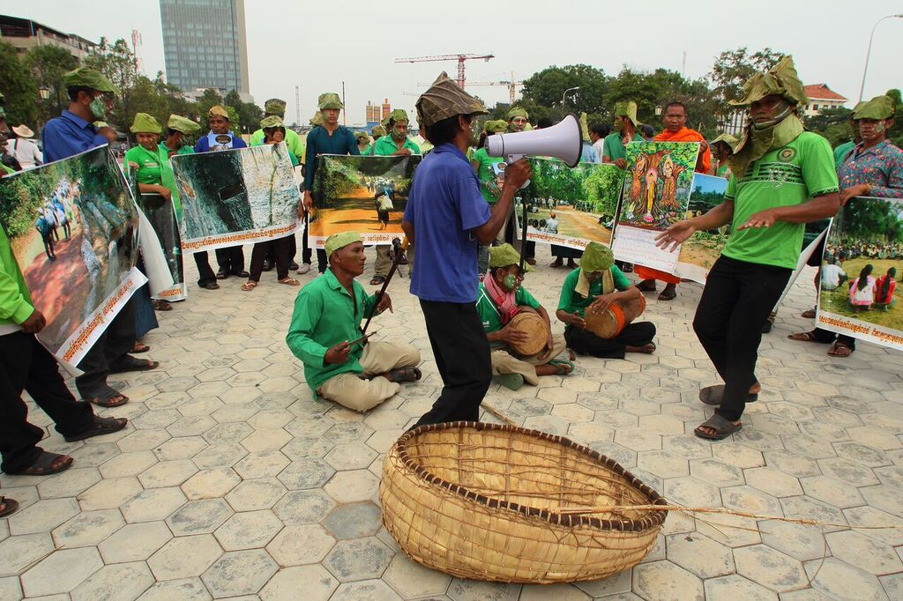
Our Responses
1. Raising awareness of law and the essence of natural resources and Tradition and Culture of indigenous communities.

Slide 9
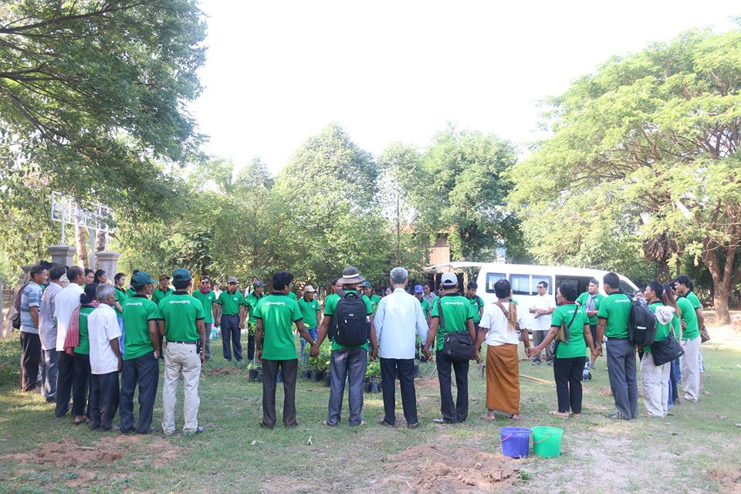
2. Commit to active non violence, active community problem solving and reconciliation and use legal procedure only when needed

Slide 10
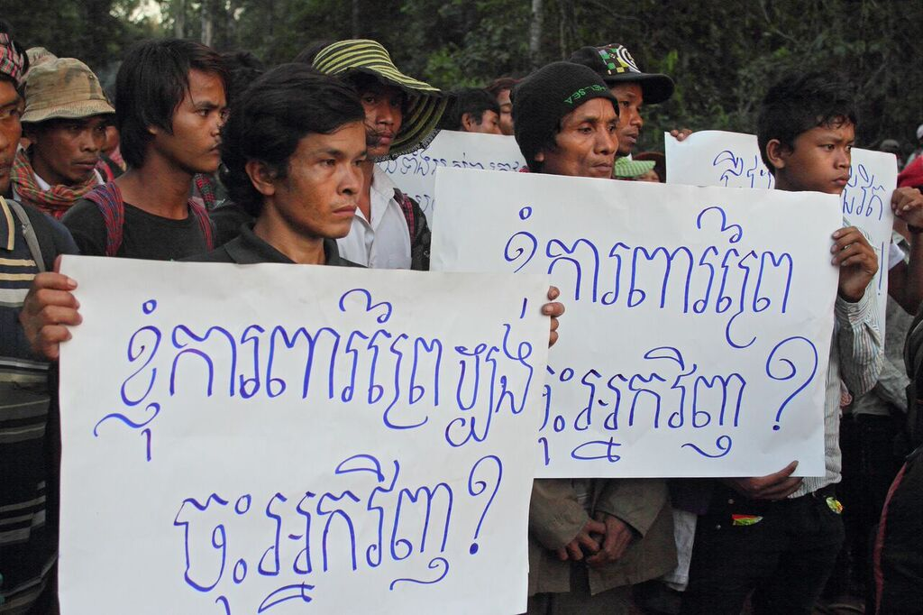
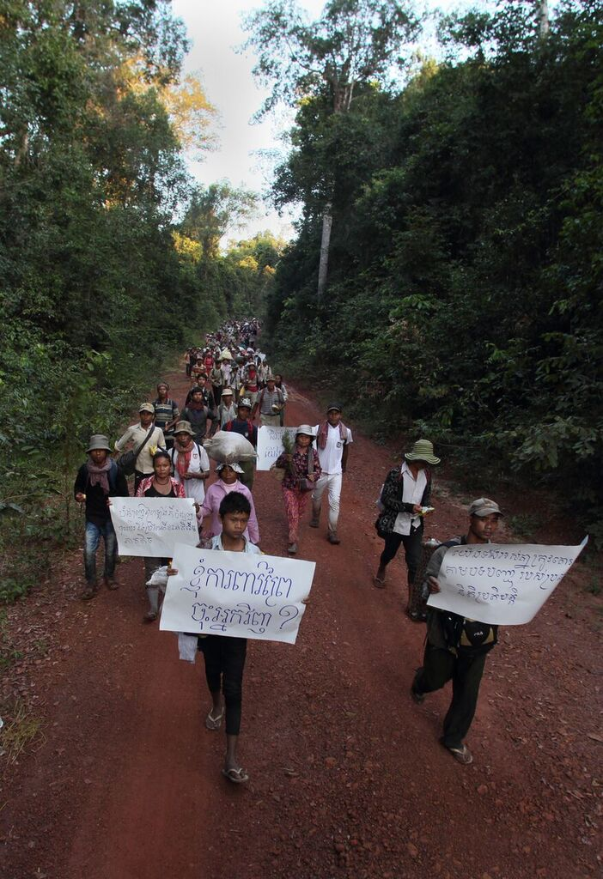
3. Alternative Conflict Negotiation and Resolution with private companies and Peaceful/Active non violence rally/marching

Slide 11
Innovation Partnership
Peacebuilding and Conflict Resolution
Community Mobilization
Livelihood
Information Technology Research

Slide 12
